Slide 1
Intro to CSS
Sandeep G

Slide 2
Who Am I?
Engineer / Front End developer
Worked in Software AG, MSFT, SAP
~9 years of experience
Worked in React JS, TypeScript, JS, CSS, HTML

Slide 3

Agenda
Intro to CSS
CSS Anatomy
Ways to add CSS in HTML file
CSS Selectors
CSS Colors
CSS Typography

Slide 4
Introduction to CSS

Slide 5


CSS - Cascading Style Sheet
HTML helps to create the fundamental structure of the website.
But, we got to use CSS in order to make it more appealing!
Basically, CSS defines a set of rules which helps in controlling the presentation of HTML element.

Slide 6

CSS - Thinking Inside The Box!
You can imagine it as an invisible box around every HTML element.
CSS allows you to control how each of these box would look.
You can do things like -
Add borders
Add spaces
Manage width, height
Add background etc.

Slide 7
CSS Anatomy

Slide 8
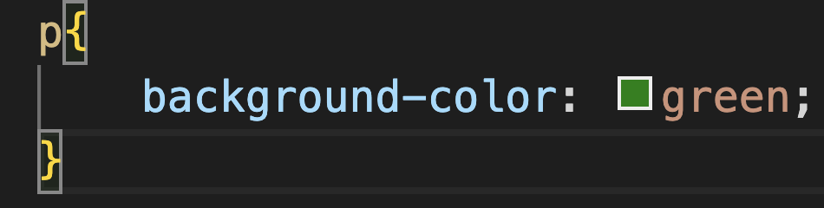
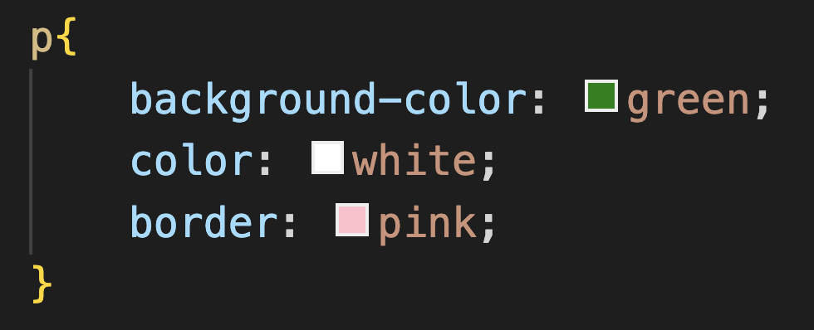
CSS Anatomy
Key-pair value separated by semicolon
CSS works in association with the HTML elements.
So, in order to define style for a particular element, we write something like this -
The above mentioned syntax applies background color to all the elements of type paragraph <p>.
selector
Style rules

Slide 9
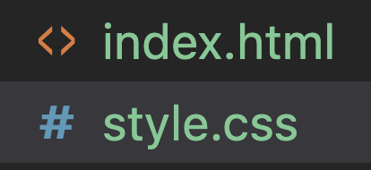
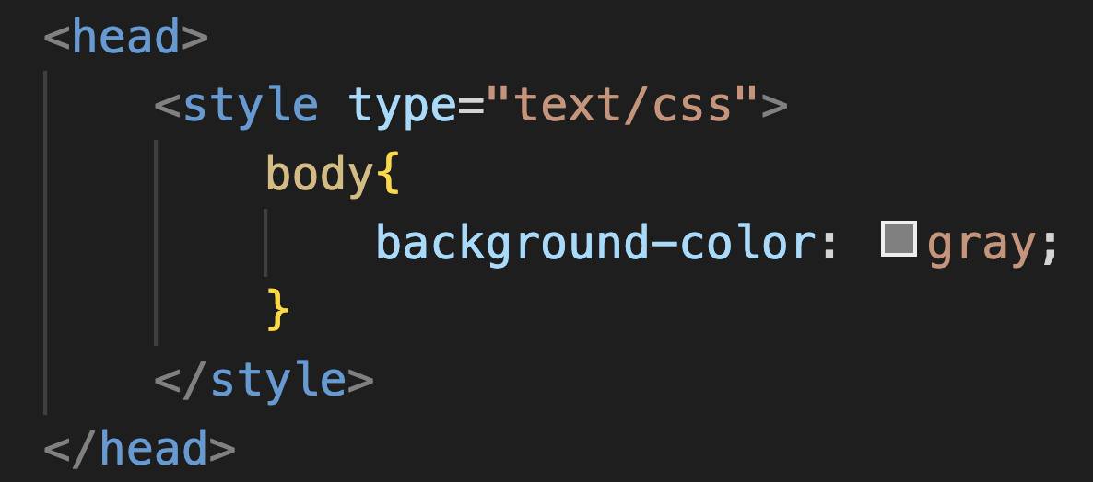
Ways to add CSS in HTML
Inline Styling - you can add style to an HTML element with “style” attribute.
External Styling - In this method, you create a separate file, and then import it in your HTML document. We use <link> tag in order to link a CSS file with our HTML document.
Using <style> tag - You may write css in HTML file itself.

Slide 10
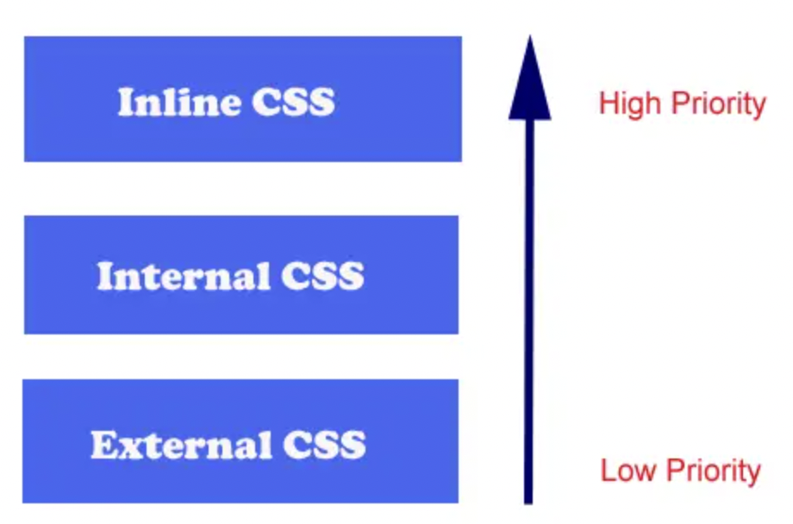
CSS precedence

Slide 11
CSS Selectors

Slide 12

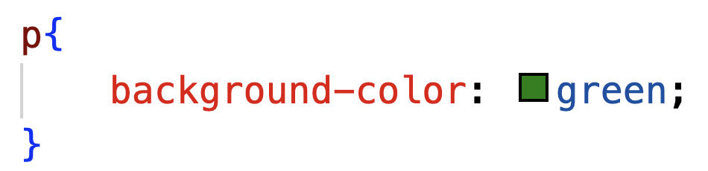
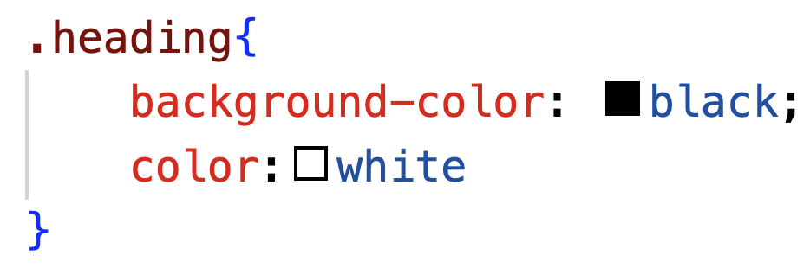
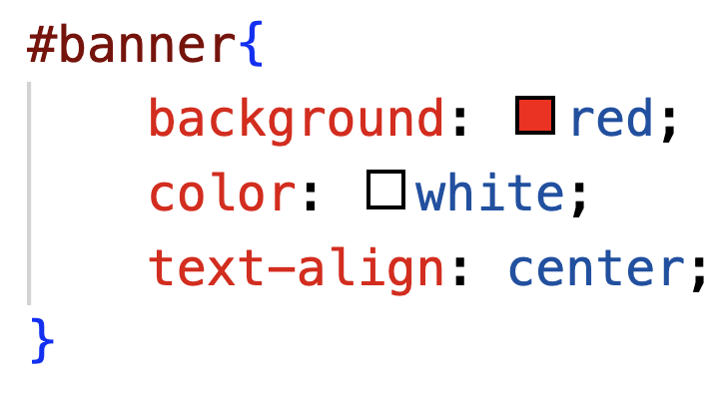

CSS Selectors
CSS selectors help you to target a specific HTML element which you want to style.
Following are some of the major type of selectors -
Universal selector - Selecting all the elements in an HTML file.
Type Selector - Selects a all the HTML element, of the given type
Class selector - Selects the html element with the given class. It’s useful when you want to apply style to similar elements A dot(.) is used to specify a class in css.
Id Selector - Selects an unique element in HTML document, to give a Unique style to it. Hash(#) is used to specify an ID

Slide 13
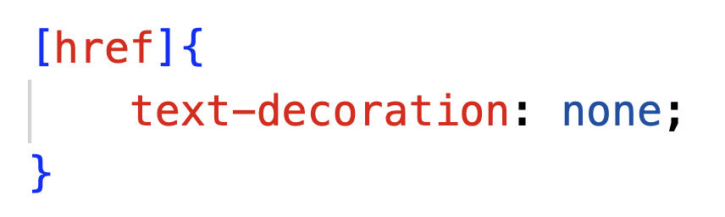
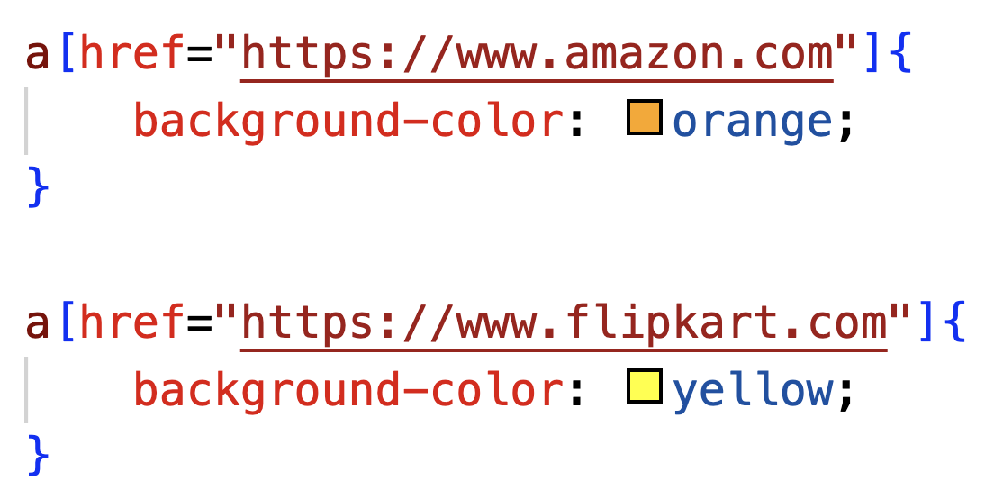

CSS Attribute Selectors
Attribute selectors - It can be used to target elements which have the specific attribute. In the screenshot, it would select all the HTML elements, having href attribute.

Slide 14
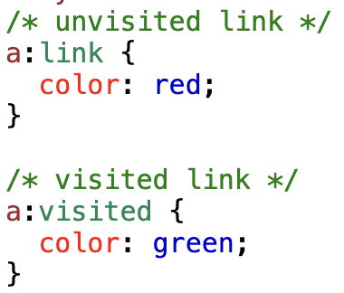


CSS Pseudo-Class Selectors
Pseudo class - It is defined as the special state of an element. These special state occurs when user interacts with the element. E.g. hover, visited, etc.
After clicking on link

Slide 15
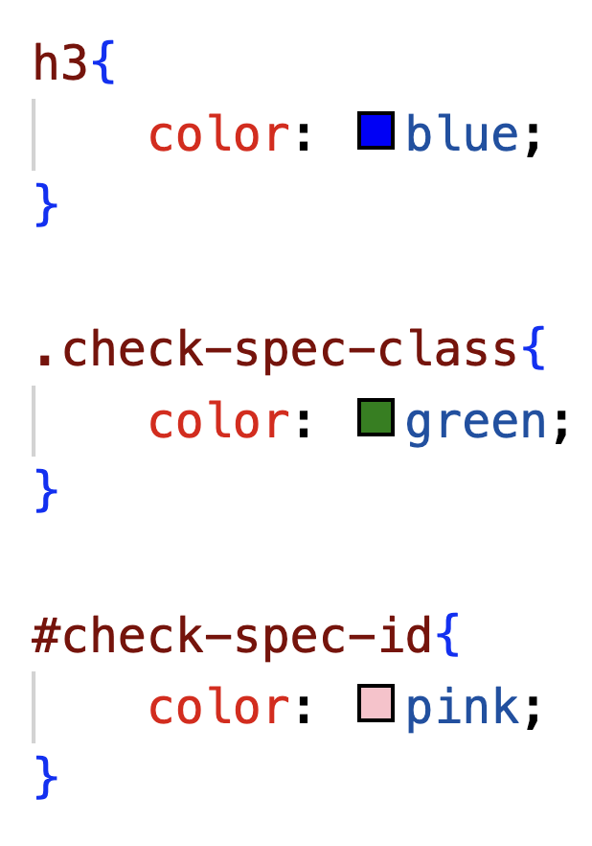
Specificity of css selector
It is defined as the order(precedence) by which css styles will be displayed.
ID >> CLASS >> TYPE
What would be the color of the h2 element?

Slide 16
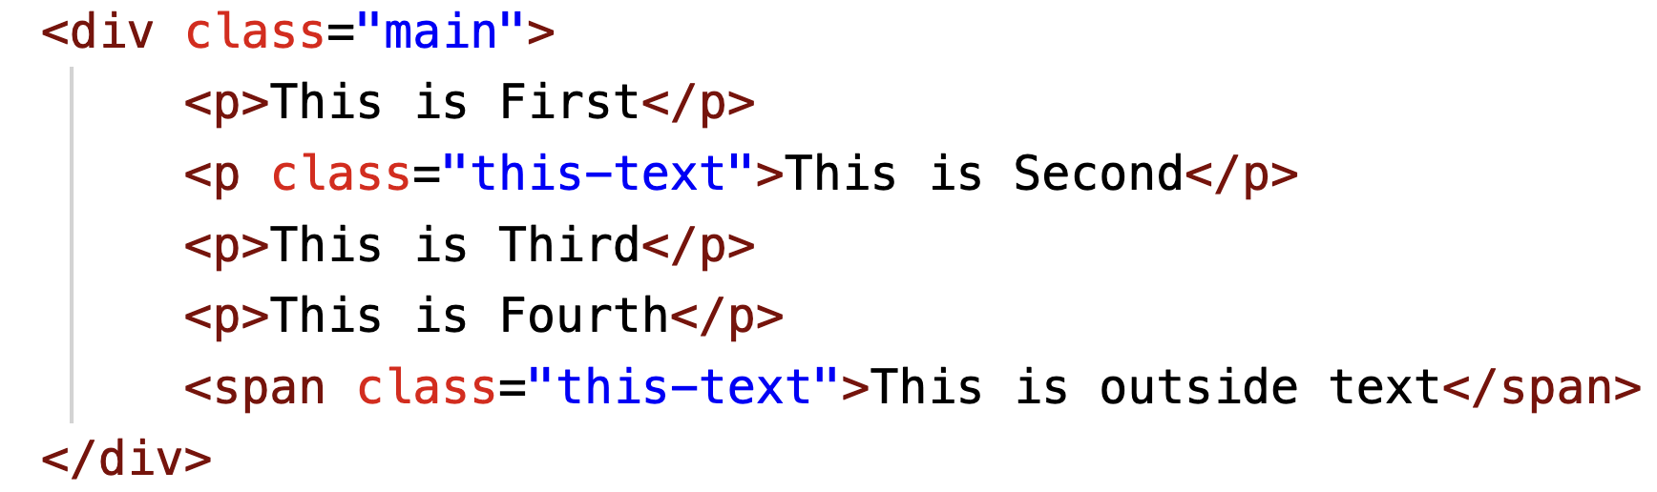
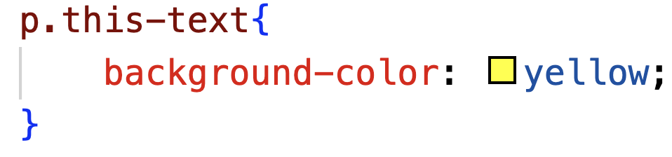
Chaining CSS Selector
We can write multiple CSS selectors in order to target a specific element. E.g. if there are multiple p tags, we can select the 1 with the given class
This way of writing multiple selectors is called chaining CSS Selectors.
Which one of the text would have the bg color "yellow”

Slide 17
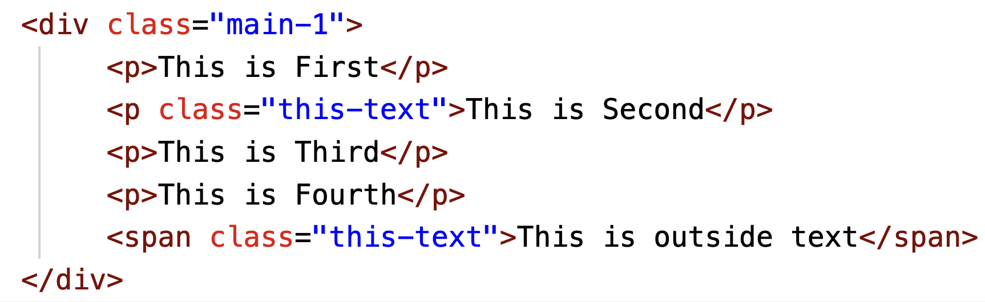
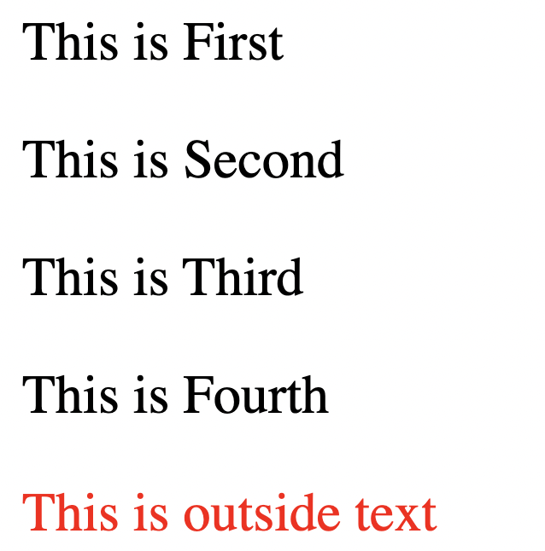
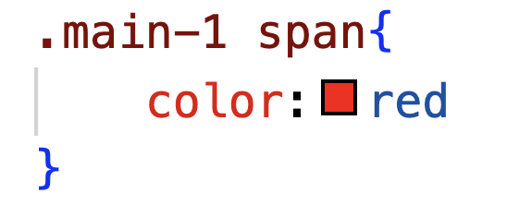
Descendent CSS Selectors
CSS gives you an option to select an element which are descendent to the give class or id.
Aim: Select the span inside an element with class “main-1”

Slide 18
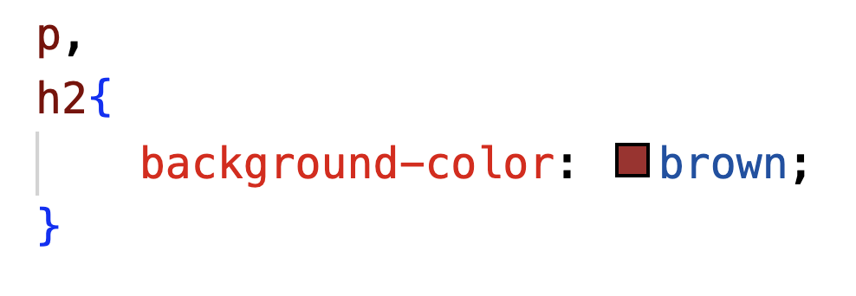
Same style multiple selectors
It is useful when you wish to apply same styles to multiple selectors. We can achieve it writing the selectors comma separated. E.g. we wish to apply the brown background to all the P elements and H2 elements at once.

Slide 19
CSS Colors

Slide 20
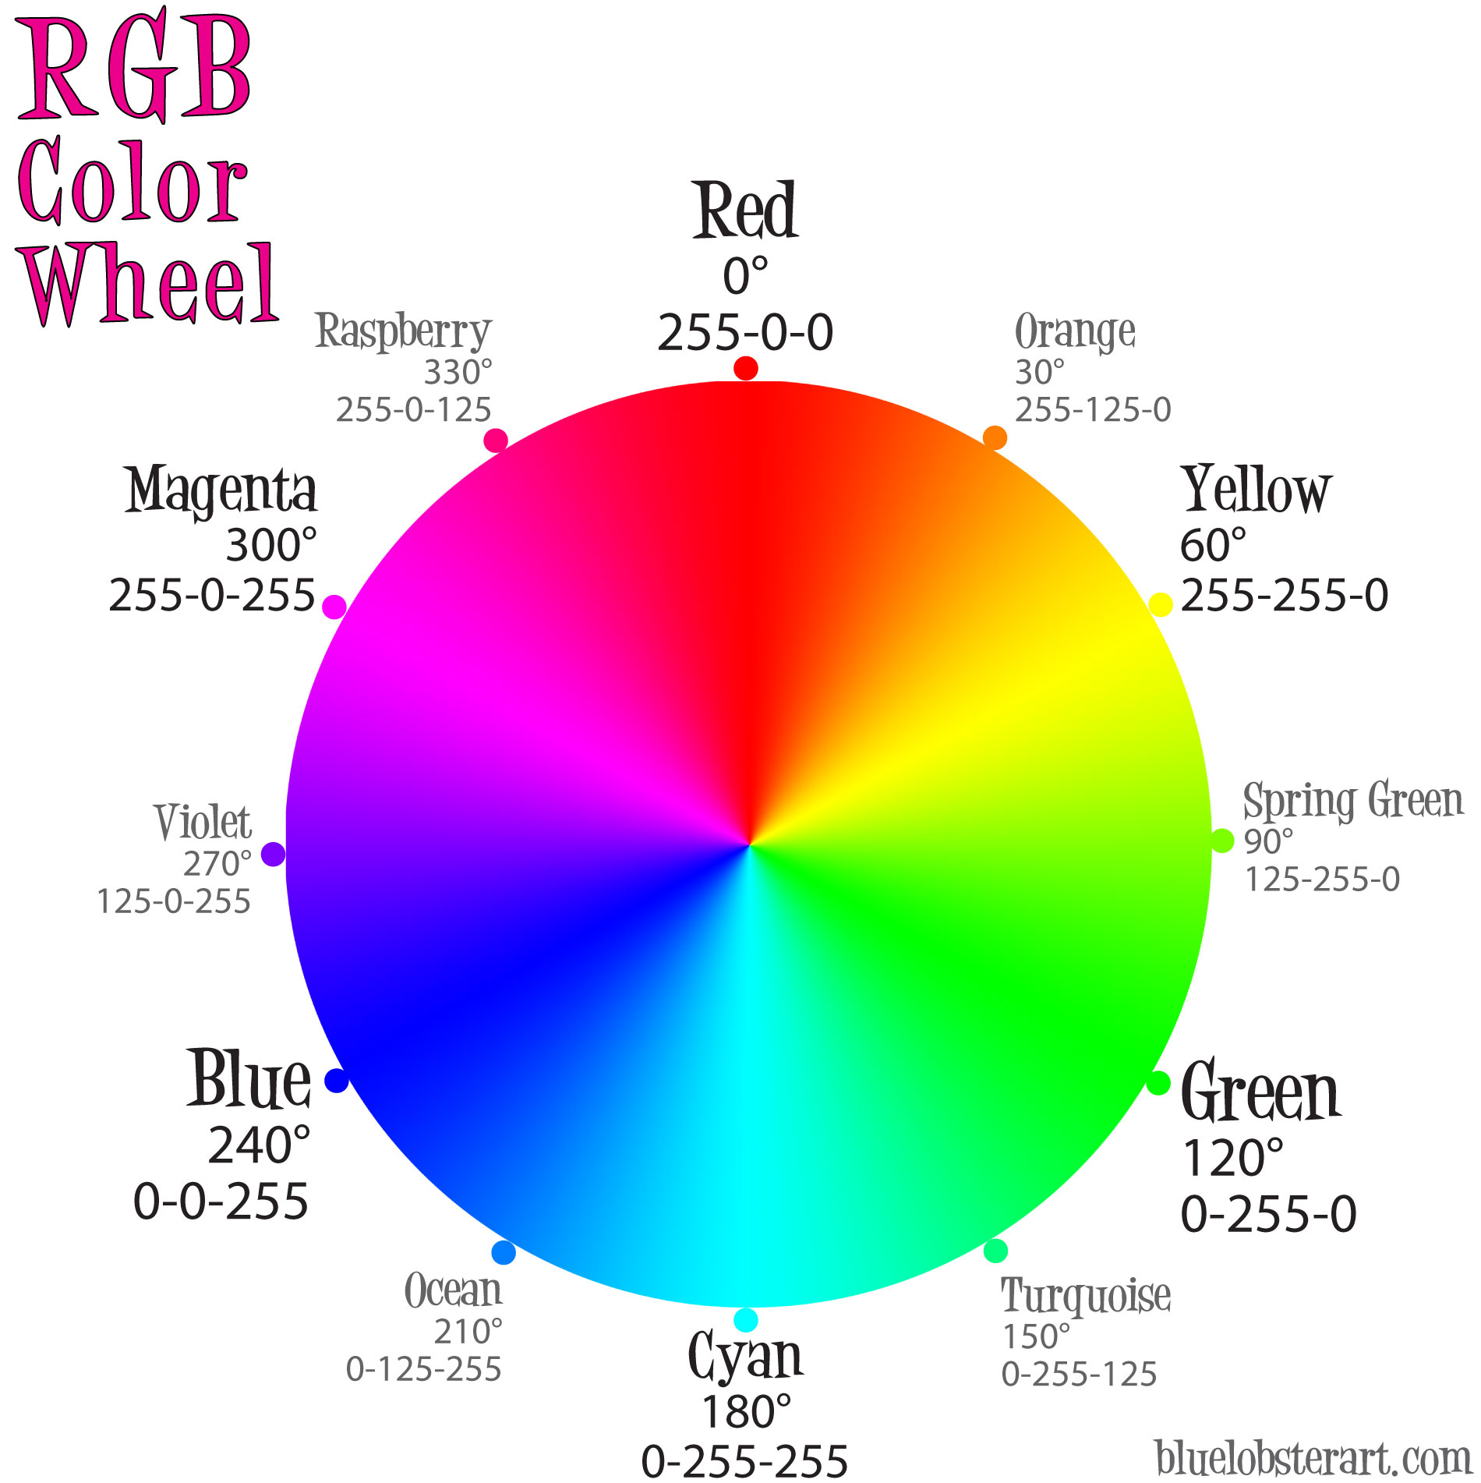

CSS Colors
CSS supports a wide variety of colors. They can be specified in majorly 3 forms -
Named colors - Name of the colors in english words. E.g. Red, Blue, Green, etc.
RGB colors - Numeric values which describes a color in the proportion of red-green-blue color. E.g. rgb(255, 99, 71)
HSLA colors - Colors defined by the amount of Hue(degree on color wheel), Saturation(intensity), Lightness and Alpha(opacity). E.g. hsla(0, 100%, 50%, 1)
HEX colors - Colors can also be defined in hexadecimal. E.g. #3cb371
Background color
Color

Slide 21
CSS Typography

Slide 22
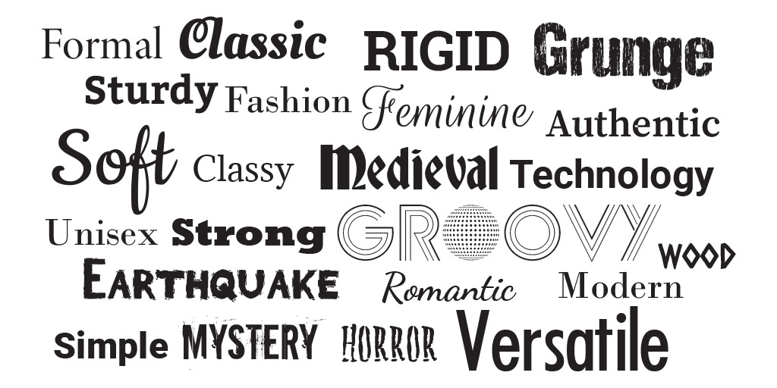
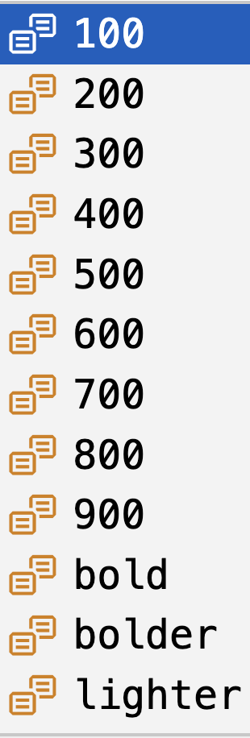
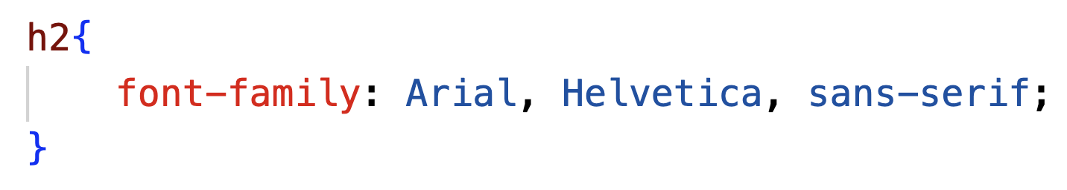
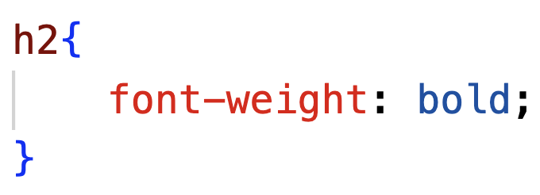
CSS Typography
Typography is the art of arranging letters and text in a way that makes the copy legible, clear, and visually appealing to the reader.
In CSS we decide the font of a given element using “font-family”
We can also control the boldness of the font using “font-weight”. It can have values - *

Slide 23





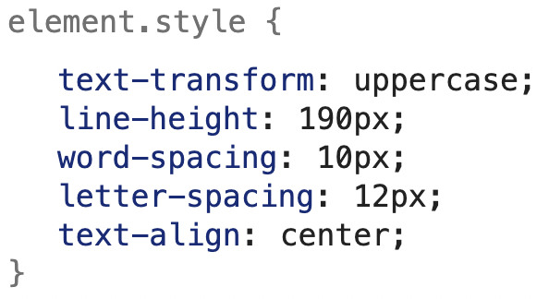
Styling Fonts
CSS also provides additional options like - making the letters italic.
You can convert all letter to uppercase -
Please explore the use of letter-spacing, word-spacing, text-align, line-height

Slide 24
Thanks and Happy coding!

